Slide 1



.
HACKBIT-2021(Round-1)
Team Name: TITANS
Gokulprasath . R
Hariguptha . A
Ragul . S

Slide 2

Problem Statement
Currently, many are not aware of the Indian Constitution and many people do not know about the rules and regulations in the Indian Constitution.
How can someone know about the laws and act applicable for his/her social problem ? The only way is to approach a lawyer by spending money , which can’t be affordable by some class of people.
But , we came up with another way!

Slide 3

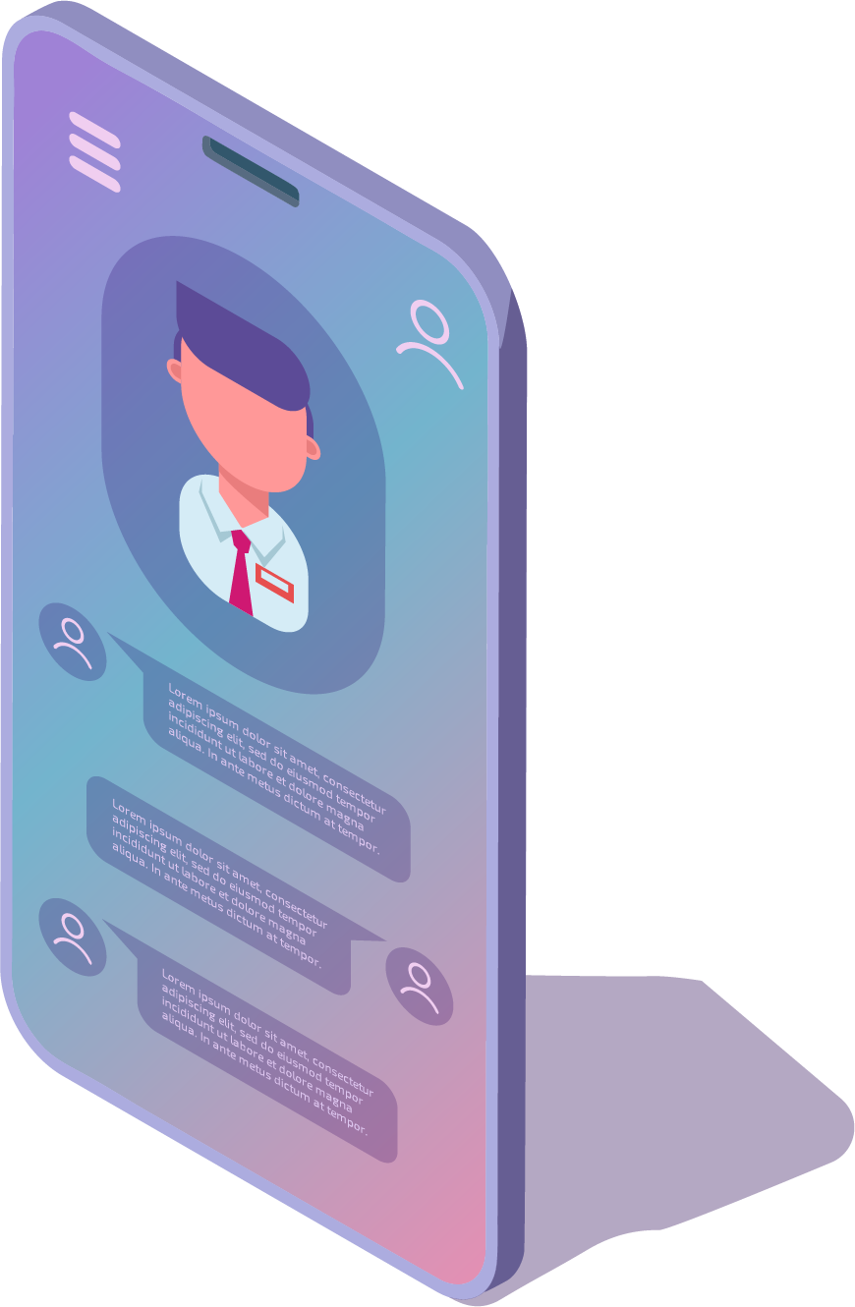
OBJECTIVE
This is a web-application in which the user can query his social problems and get to know the related Laws from the Indian Constitution through this web-app.
The objective of this web-app is to create awareness among people regarding the rules and regulations in the Indian Constitution.

Slide 4
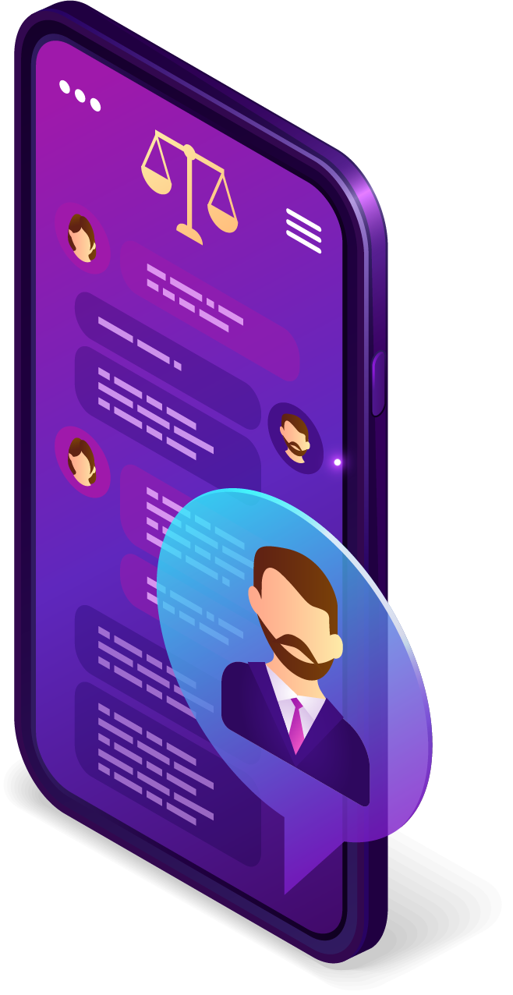
Technology Stack
The web-app provides the Laws in the Indian Constitution for the queries about the social problems faced by the user.
* For example : A group of boys from my street attempted to abuse me , but I somehow managed to escape from them .Can they be punished?
Then the chatbot displays the result as
Yes, According to section 5 ~Aggravated penetrative sexual assault,They can be punished!

Slide 5

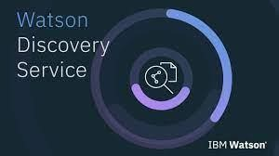
Technology Used
IBM Watson Assistant
IBM Watson Discovery

Slide 6
Use Case
This web-app can act as an alternative to a lawyer , as this app can give information regarding suitable sections and punishments.
This webapp contains a contact me page , which can be used by illiterate peoples who can’t able to chat with chatbot.

Slide 7
